Slide 1



Why does this matter to government?
What are the priorities where HRfH can make a difference for the UK?
Professor Mary De Silva
DEPUTY CHIEF SCIENTIFIC ADVISER, DHSC

Slide 2


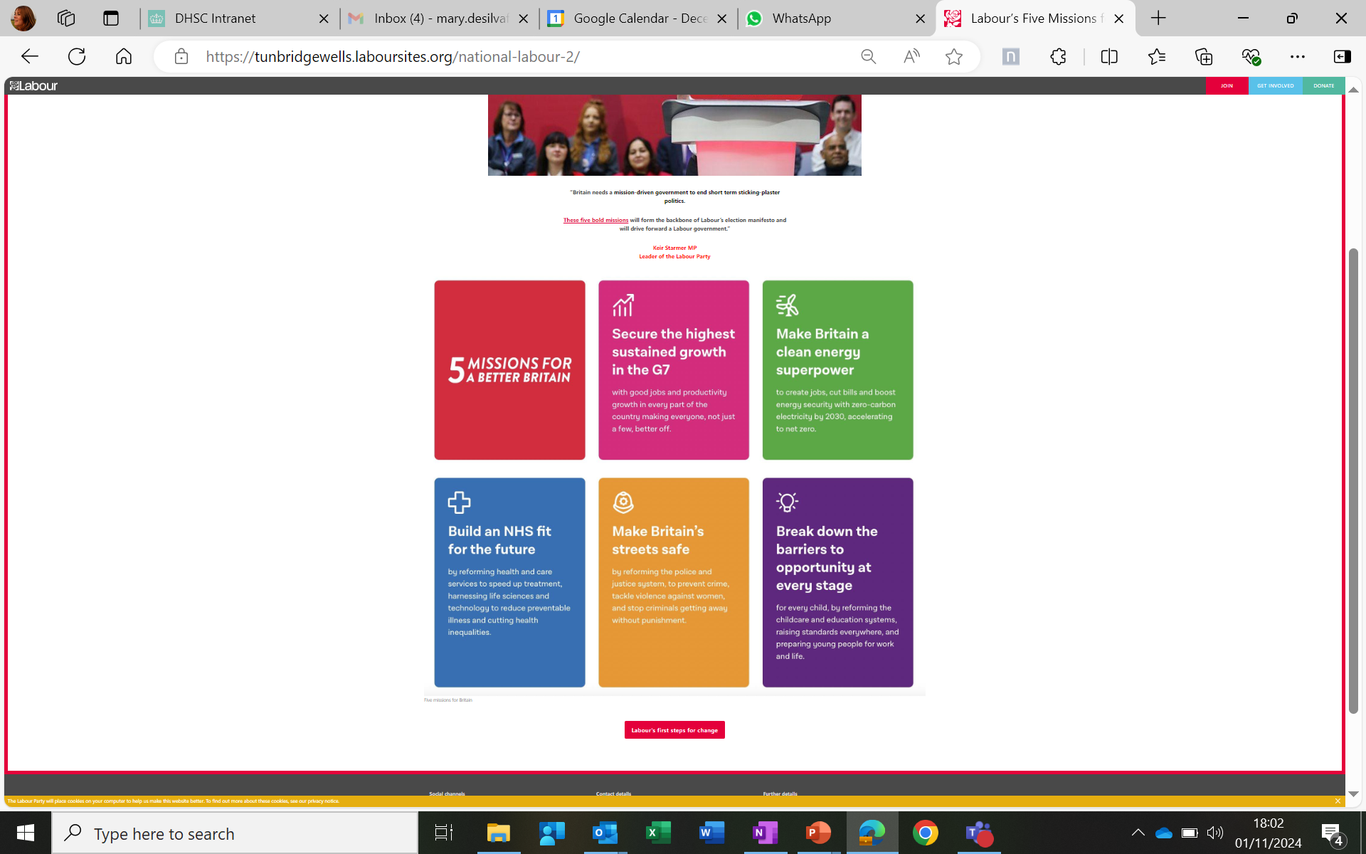



A time of Change and Opportunity
Notes:
New labour government appointed 5 July, with Wes Streeting announced as the Secretary of State for health and social care.
Health and care is a big focus for the new government (one of the missions), and this provides opportunities for research. In their first two months we have seen a focus on: AI and developing an NHS innovation and adoption strategy for new technologies, reforming incentives to support the uptake of innovative technologies across the NHS, an interest in more funding for primary care.
There has been reviews commissioned such as the review of NHS performance, led by Ara Darzi- The review’s findings will inform a new 10-year plan for the NHS. Changes at Care Quality Commission including a review of CQC’s assessment frameworks.
In addition, there have been an agreement on junior doctor pay, publication of the first report from public inquiry on government’s COVID-19 response and a commitment made to social housing.

Slide 3


Growth Mission
“If we can marry our health and social care system with the incredible life sciences and med tech ecosystem we have in this country, we can be a powerhouse for the life sciences and med tech revolution here in this country and in the world. And that is an economic growth mission.”
Notes:
In addition, economic growth is a large focus for government, across all sectors, but especially health and care.
Wes Streeting has committed to supporting the government’s growth mission by improving the health of the nation, getting people back to work and boosting the economy through our life sciences sector.
There is a focus on the NHS working hand in hand with life sciences research institutions and medical technology companies, driving the development of new treatments and helping to grow these industries. This was stated by Secretary of State at a speech at the Tony Blair institute (quote shown on slide).

Slide 4

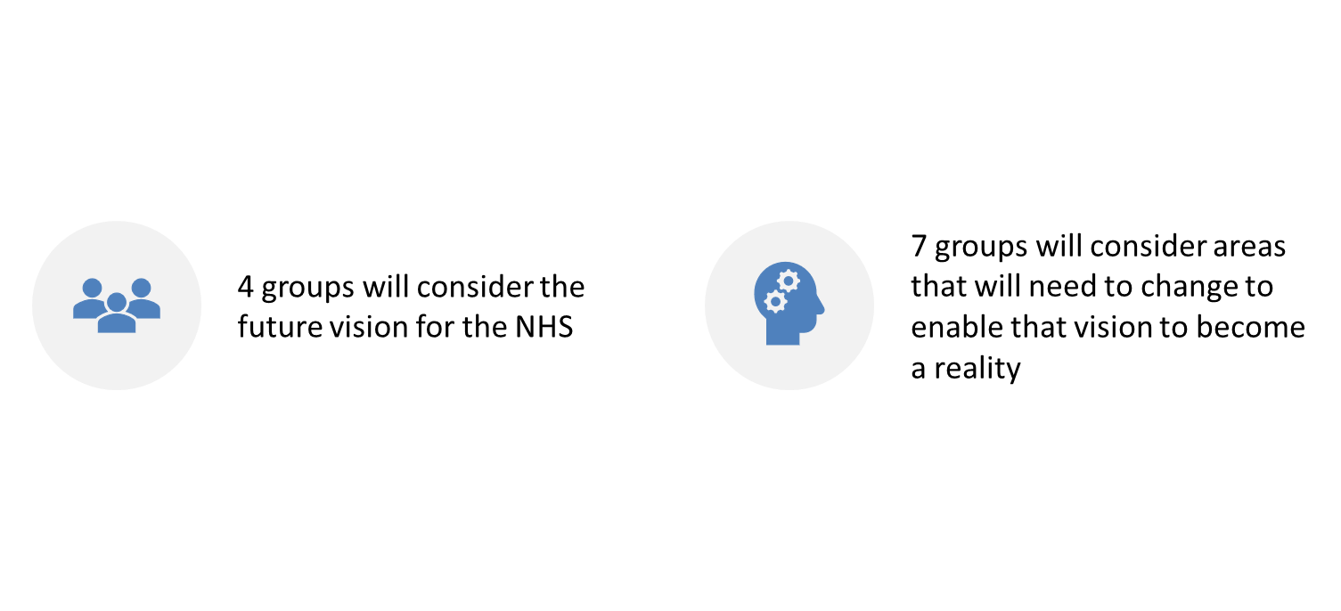
10 Year Health Plan
11 working groups have been established to support the development of a 10 Year Health Plan:
The Research, life sciences and innovation group will consider:
How the NHS can identify and capitalise on technologies over the coming decade.
How the NHS currently supports research and innovation, including in life sciences, and what we can do to increase the speed and scale of adoption of new innovations.
Notes:
In addition, economic growth is a large focus for government, across all sectors, but especially health and care.
Wes Streeting has committed to supporting the government’s growth mission by improving the health of the nation, getting people back to work and boosting the economy through our life sciences sector.
There is a focus on the NHS working hand in hand with life sciences research institutions and medical technology companies, driving the development of new treatments and helping to grow these industries. This was stated by Secretary of State at a speech at the Tony Blair institute (quote shown on slide).

Slide 5

Build an NHS fit for the future
The WHAT: the goal for the health and care system is to build a health and social care system fit for the future
Goals
An NHS that is there when people need it
Fewer lives lost to the big killers
Fairer Britain, where everyone lives well for longer
1
2
3
The HOW: reform shifts for the health and care system
Shifts
Hospital to home
Treatment to prevention
Analogue to digital
1
2
3
Notes:
The Secretary of State for health and social care, Wes Streeting, recently spoke about his three priorities for the health and care system.
The goals are:
An NHS that is there when people need it: Timely access to high-quality health and care
Fewer lives lost to big killers: Reducing premature mortality
Fairer Britain, where everyone lives well for longer: Reducing the number of years people spend in ill-health (compressed morbidity)
The priorities are:
Sickness to prevention- this includes diagnosing ill health earlier/ more accurate diagnosis. Maintaining and monitoring good health and preventing those who are more at risk of certain conditions from progressing to the disease as well as intervening early.
Analogue to digital- there is a large focus on federating data and utilising data and digital tools to support efficiencies in care and treatment.
Hospital to home – Thinking about which trials and research needs to happen in a hospital environment and what can happen in other care settings or even at home. Developing tools which allow us to do remote monitoring or deliver decentralised trials.

Slide 6

Wearables in Health and Care
Opportunity: Wearables offer a unique ability to support the three health mission shifts.
Shifts
Hospital to home
Treatment to prevention
Analogue to digital
1
2
3
Enable remote monitoring and care delivery
Detect early warning signs and encourage healthy behaviours
Integrate real-time data for proactive care
.​
Notes:
SofS and SpAds are keen to include something on Wearables in the 10 Year Health Plan. This was communicated publicly as part of the 10YHP launch last year.

Slide 7
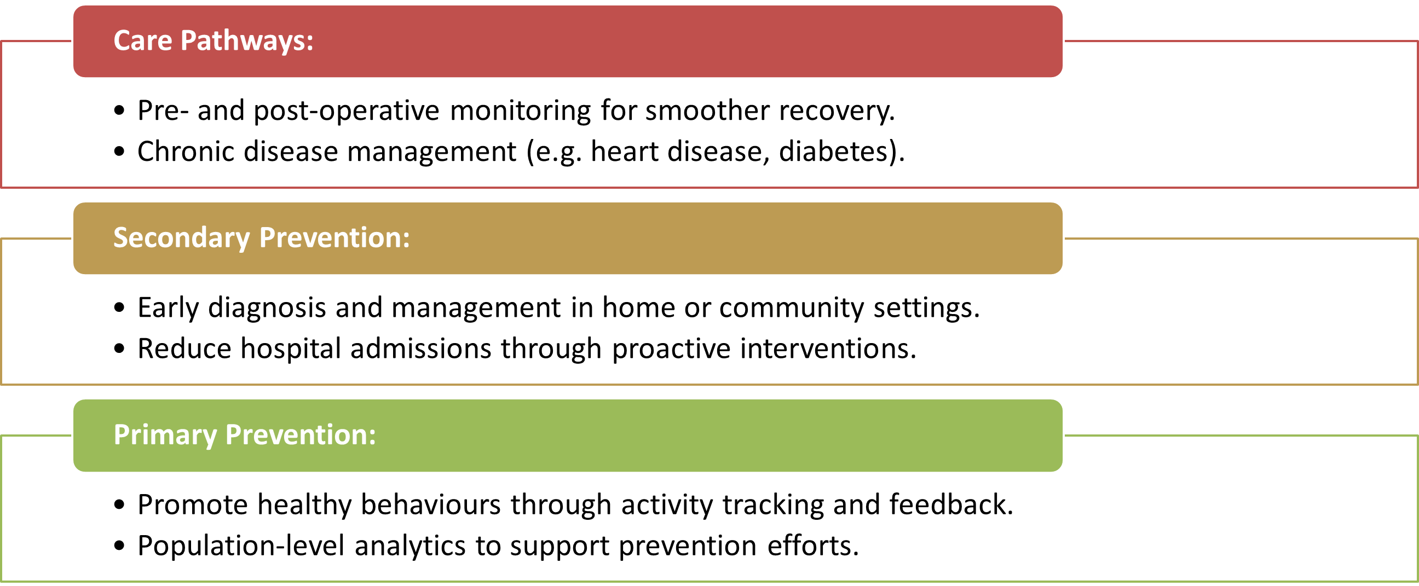
Areas of potential impact for wearables
Key Considerations
•Regulation: Ensuring wearables meet safety, efficacy, and usability standards.
•Data Integration: Linking patient-generated data with NHS systems for effective clinician use.
.​
Notes:
SofS and SpAds are keen to include something on Wearables in the 10 Year Health Plan. This was communicated publicly as part of the 10YHP launch last year.

Slide 8
Innovation
Life sciences, innovation, medical technologies and Research and Development (R&D) are critical for delivering these missions.
Health and care research powers the country’s life science sector and technical advantage.
Vision: Rapid development of implementable game changing innovations (GCI) driven by demand from the health and care system, stimulating industry investment and delivering patient, public and economic benefits.

Slide 9

System Challenges
Lack of Demand Signalling and Horizon Scanning
Disconnected funding programmes and infrastructure
Very little late-stage funding
Unclear regulatory system for health tech
Little pull through from the system
Lack of implementation science
Unprepared regulatory frameworks,
Unclear routes into procurement
Lack of capacity of health and care staff.
R&D systems are not keeping pace with the rate of technological development. Innovations which could revolutionise the health and care system take too long to develop and are ‘handed on’ for adoption without evidence of how to implement and scale them, compounding slow adoption.

Slide 10

Project pitfalls
Neglecting Stakeholder Engagement
Lack of Demand
Weak Business Model
Scalability and Adoption Issues
Not involving industry partners, clinicians, end-users, or regulatory bodies
Needs driven innovation will be prioritised to succeed
Too much focus on technical development while neglecting market needs, pricing, or revenue models
Unforeseen technical difficulties or implementation issues

Slide 11
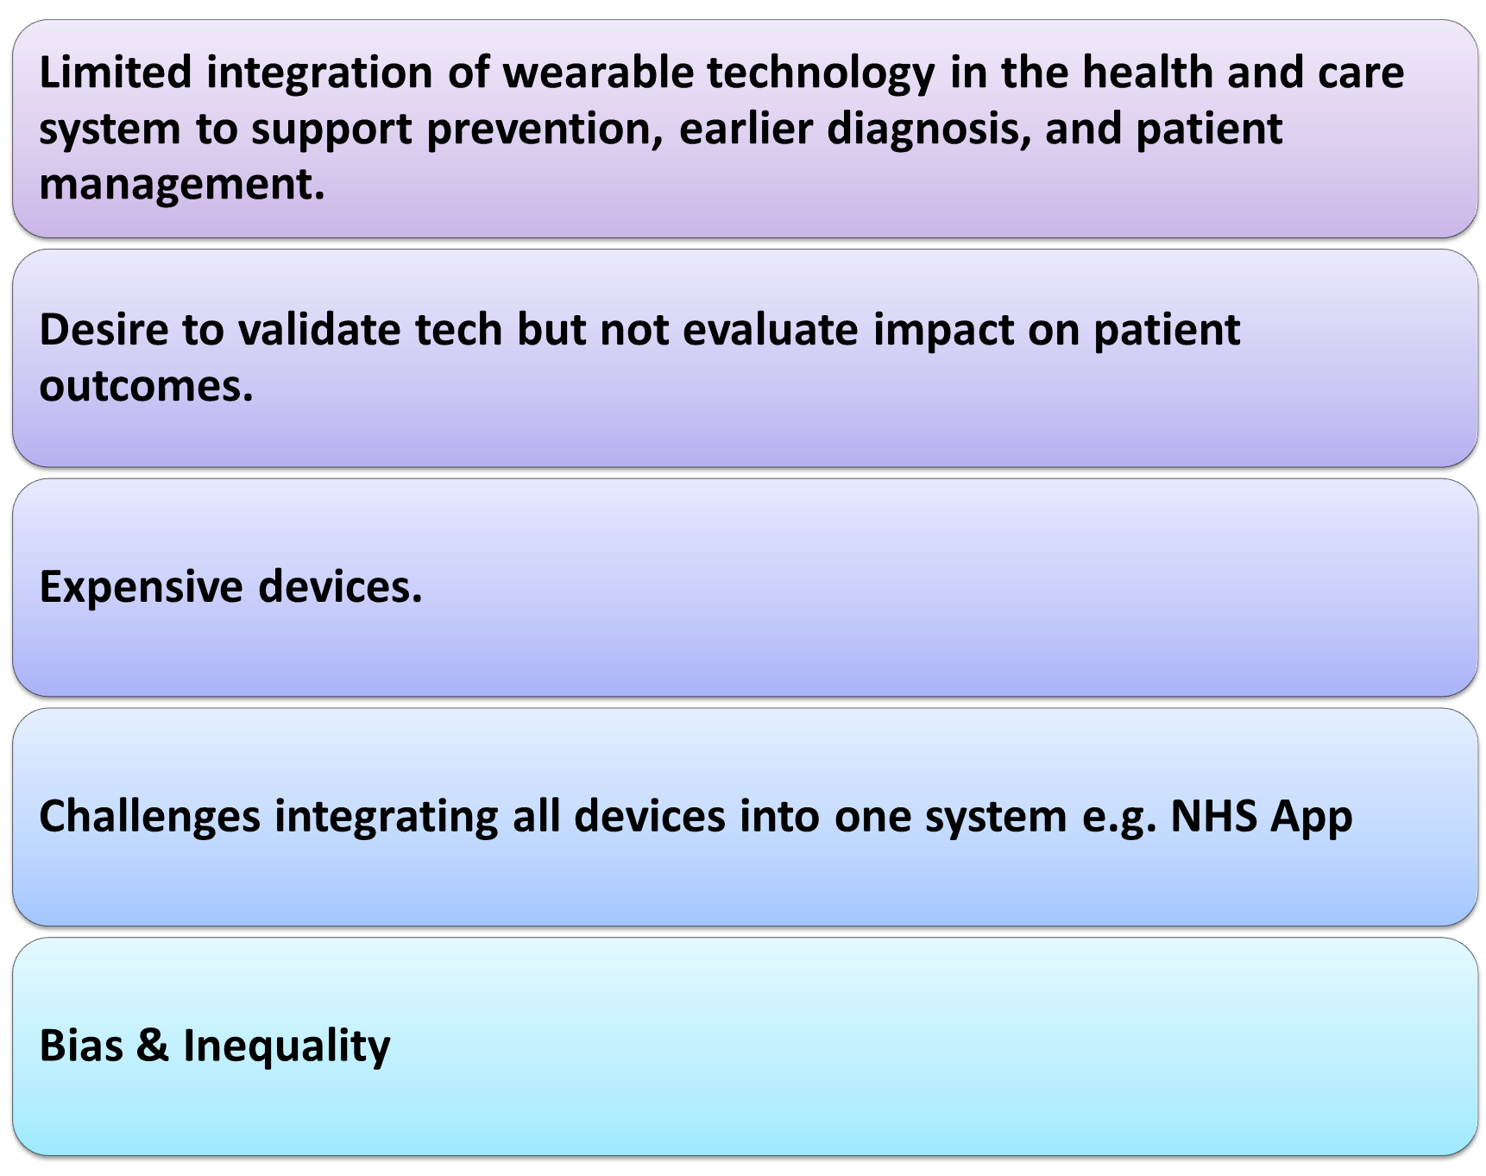
Wearables research challenges
.​
Notes:
SofS and SpAds are keen to include something on Wearables in the 10 Year Health Plan. This was communicated publicly as part of the 10YHP launch last year.

Slide 12

New NIHR Research Innovation strategy
Vision: Rapid development of implementable game changing innovations (GCI) driven by demand from the health and care system, stimulating industry investment and delivering patient, public and economic benefits.
Aims:
Make the UK’s R&D innovation ecosystem more efficient, with better pull through to adoption
Drive growth in life sciences through inward investment by building confidence for industry and investors, focusing on key technologies with UK advantage (AI, quantum sensing, engineering biology, genomics, wearables)
Deliver innovations which increase productivity in the health and care system and improve patient and public outcomes

Slide 13
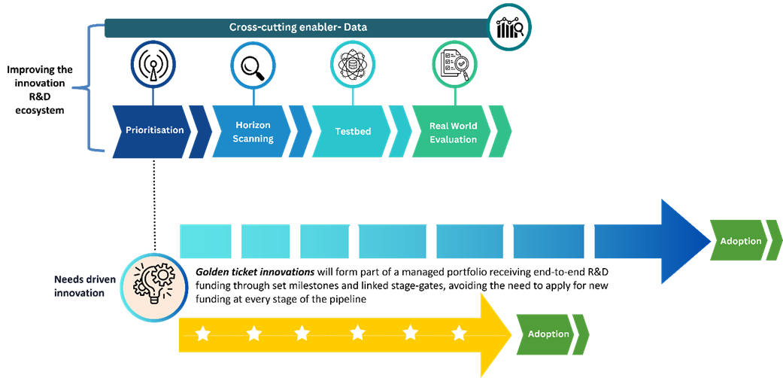
New NIHR Research Innovation strategy

Slide 14



NIHR Programmes and Research Infrastructure
Invention for Innovation (i4i) is a translational research funding programme for medtech innovations
The Health Technology Research Centres (HRCs) accelerate the development of healthcare technologies to improve the effectiveness and quality of health and care services.
Notes:
Our HealthTech Research Centres (HRCs) are centres of excellence located in leading NHS organisations across England.
They accelerate the development of healthcare technologies to improve the effectiveness and quality of health and care services. They do this by helping medical device, digital technology and diagnostic companies (collectively known as healthtech) to develop, evaluate and validate new innovative health technologies to address pressing healthcare challenges. This includes help to generate evidence to demonstrate financial value (health economics) or improve operational efficiency in the NHS (real-world evidence generation).

Slide 15

Thank you
Notes:
New labour government appointed 5 July, with Wes Streeting announced as the Secretary of State for health and social care.
Health and care is a big focus for the new government (one of the missions), and this provides opportunities for research. In their first two months we have seen a focus on: AI and developing an NHS innovation and adoption strategy for new technologies, reforming incentives to support the uptake of innovative technologies across the NHS, an interest in more funding for primary care.
There has been reviews commissioned such as the review of NHS performance, led by Ara Darzi- The review’s findings will inform a new 10-year plan for the NHS. Changes at Care Quality Commission including a review of CQC’s assessment frameworks.
In addition, there have been an agreement on junior doctor pay, publication of the first report from public inquiry on government’s COVID-19 response and a commitment made to social housing.

Slide 16

NIHR research generates ideas and technologies which translate to real-world benefits for patients, the public and the UK economy. This is enabled through the commercialisation of new products and services and the promotion of collaborations between researchers and industry. This activity supports the UK life sciences industry, the academic sector and makes a significant contribution to the innovation economy.
Notes:
NIHR can help to address these challenges and pitfalls

Slide 17

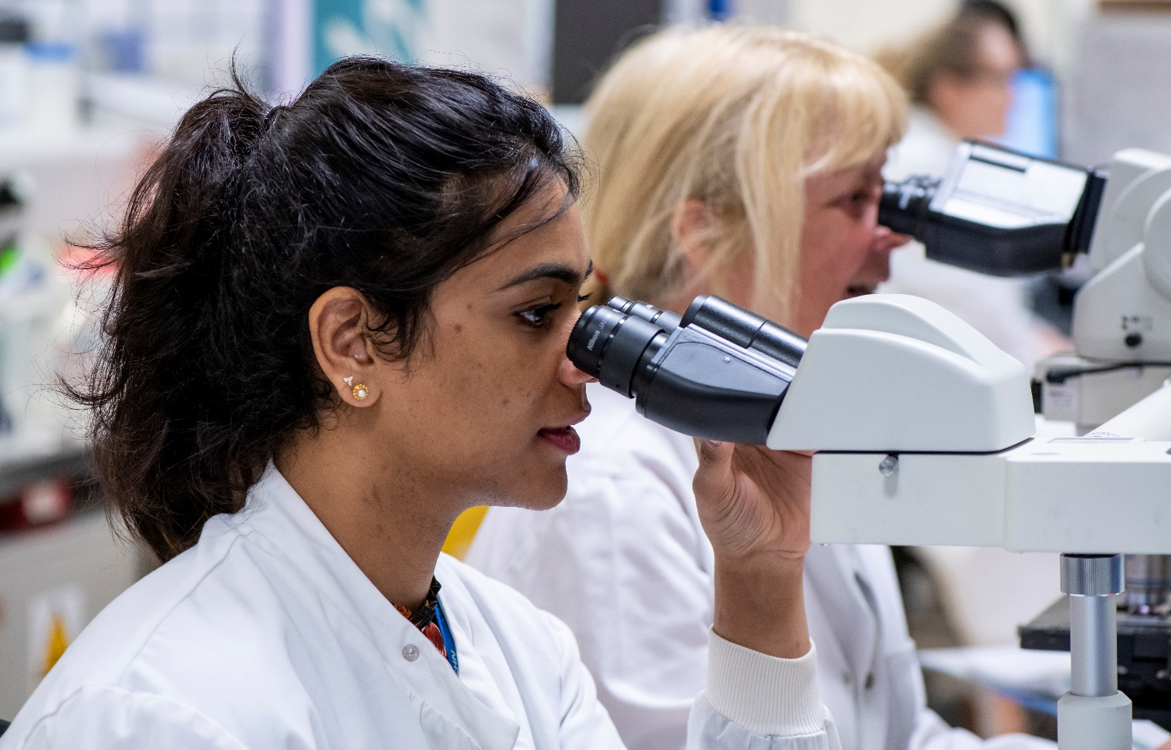


NIHR funds, enables and delivers world-leading health and social care research
We fund or part-fund over 10,000 front-line research delivery staff throughout the NHS
We’re funding more than 1,000 active health and social care research projects
More than 2,000 researchers hold our career development awards
More than a million participants take part in research supported by the NIHR each year
Notes:
The National Institute for Health and Care Research’s mission is to improve the health and wealth of the nation through research.
Working in partnership with the NHS, universities, local government, other research funders, patients and the public, NIHR funds, enables and deliver world-leading health and social care research that improves people's health and wellbeing and promotes economic growth.
NIHR invests more than a billion pounds a year in research.
This funding goes towards research projects, career development awards, and the people, facilities and technology that enable research to thrive.

Slide 18




NIHR’s 4Is
Notes:
NIHR has developed the 4I’s to show how NIHR is meeting government aims.
The four areas of focus are:
Impact- Articulating how NIHR funding delivers impact which ultimately saves lives and improves people’s quality of life.
Inclusion – NIHR research is shaped and funded by the public. It is critical that our research represents the diversity of the population or those most at risk of the disease/area of focus to deliver the best science and benefits for all.
Innovation- NIHR funding powers the country’s life science and technical edge. We are seeing how innovations developed by NIHR funded infrastructure and programme grants transform the health and care system
Investment- NIHR infrastructure drives economic returns, inward investment and economic growth. It creates jobs, encourages companies and academics to work in the UK or collaborate with our researchers. It also improves the health of the nation, getting people back into work and living healthier lives.
The NIHR is crucial in driving forward innovations which meet the needs of the public and improve the health and care system. It is vital that we have visibility of NIHR funded infrastructure and that the ATTCs promote that they are funded by government, through the NIHR, to improve the public and ministers’ understanding of how the government is funding health and care research and their achievements in health and social care research.

Slide 19
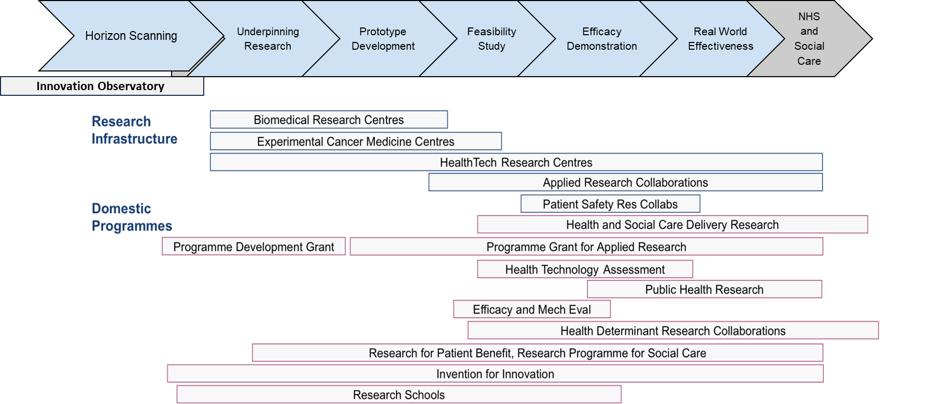
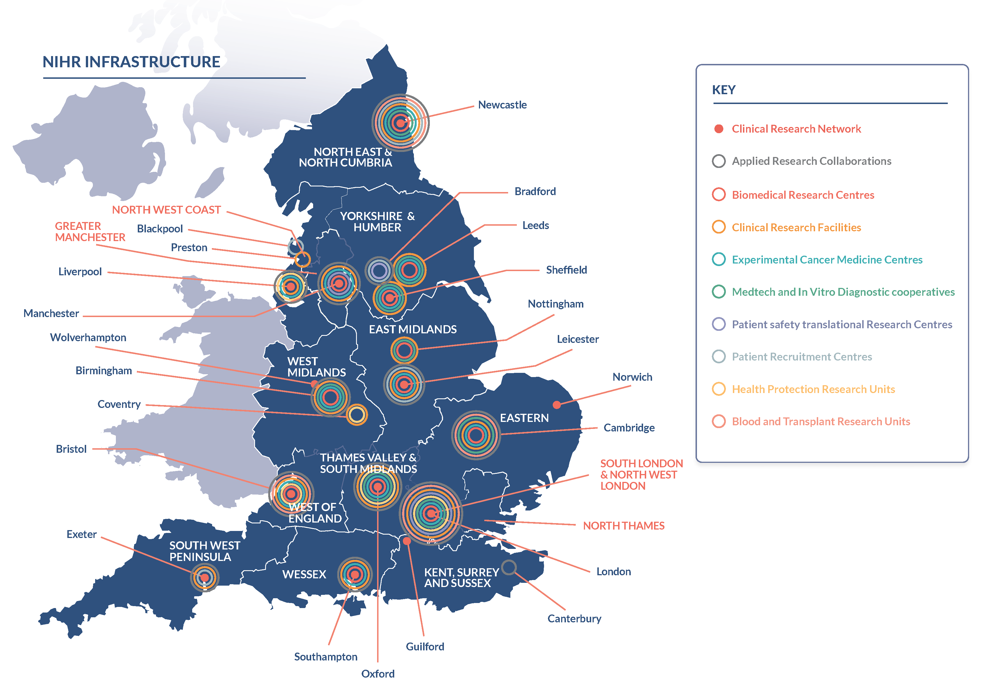
NIHR Programmes and Research Infrastructure
Notes:
NIHR supports many stages of the R&D innovation cycle, from horizon scanning, early development through to implementation, driving innovation by generating the real-world evidence and evaluations required for adoption.

Slide 20
Inclusion
NIHR research identifies areas of under-representation, builds research capacity, and collaborates with the public to address health and care inequalities
Inclusion enhances research impact. To address the needs of the public and enable better targeted and more cost effective health and social care, our research must be representative and inclusive. NIHR research provides evidence to understand populations that are under-served by health and social care research. We build relationships, resources and research capacity across under-represented communities and professions, and deliver evidence in collaboration with the public and health and social care system to enable implementation.

Slide 21

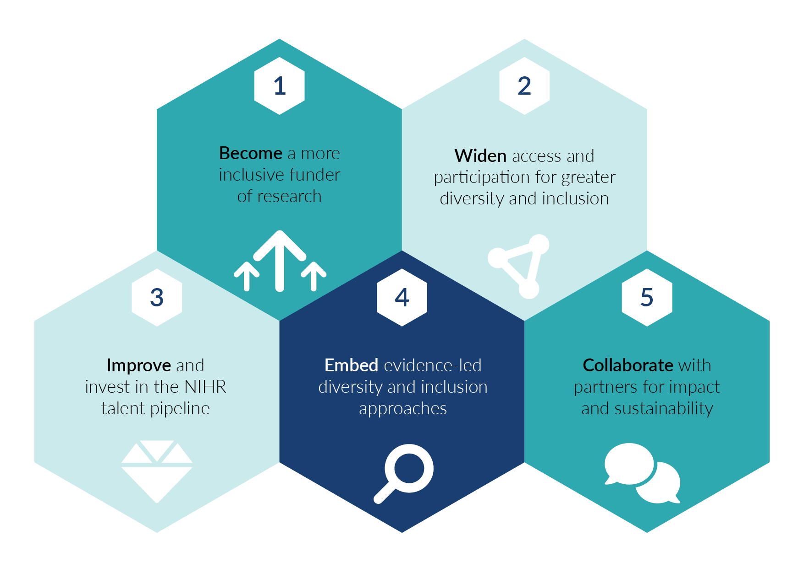
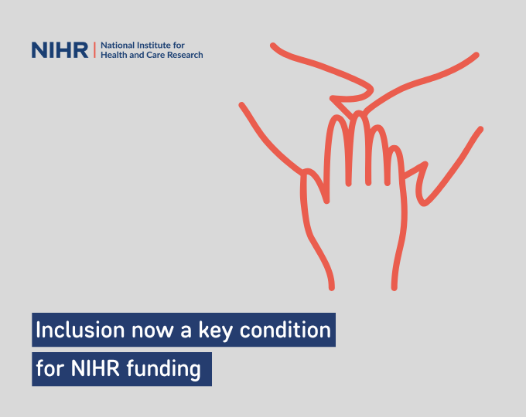
NIHR Research Inclusion Strategy

